Slide 1
EE2023
Signals & Systems
Group 1 Lecturer : A/Prof Loh Ai Poh
Venue of Classes : E5-03-19
Tel : 65162292
Email : elelohap@ nus.edu.sg

Slide 2
REFERENCES
Douglas K Lindner, Introduction to Signals & Systems, McGraw Hill
Hwei Hsu, Schaum's Outline of Signals and Systems, McGraw Hill
Others
Simon Haykin, An Introduction to Analog & Digital Communications, John Wiley & Sons, Inc
Leon W. Couch, II, Digital and Analog Communication Systems, Prentice-Hall.
A.V. Oppenheim, A. S. Willsky, Signals & Systems, Prentice Hall, 2nd ed.

Slide 3
ASSESSMENT MODE
Quiz (25%) - Closed-book around 7th week
Assignment (15%) - Around 11th week
Exam (60%) - Closed-book
Tutorials will be discussed as and when ready. Hence week 1 second lecture/tutorial slot is a lecture slot – not tutorial, so please turn up
No labs in this course. The concepts covered here will be re-visited in the lab module EE2032 Signals & Communications Design Lab

Slide 4
Outline of syllabus and Topics
Signal Representation, Fourier Series and Transform
Spectrum of Continuous Time Systems
Energy, Power, Bandwidth of Signals
Sampling and Signal Reconstruction
Linear Time Invariant (LTI) Systems
Propagation of Signals Thru a LTI System
Frequency Response of LTI Systems
Notions of Stability : When do signals become unbounded?
Discrete Time Fourier Transform (if time permits)
Examples of Real Signals and Systems

Slide 5
Learning Outcomes – first half of semester
Describe a signal in time and frequency domains
Fourier Series and Fourier Transform – properties
Spectrum of Periodic and Aperiodic Signals
Calculate the bandwidth, power and energy spectral densities of signals
Explain aliasing and evaluate the impact of the Nyquist sampling theorem

Slide 6
Learning Outcomes – second half of semester
Describe and identify the characteristics of linear time invariant systems
Derive a linear time invariant system model using differential equations and transfer functions
Compute the outputs of LTI systems when driven by steps, impulses & sinusoids using convolution integrals and transfer functions
Evaluate the stability of system through its poles
Construct the frequency response of systems via Bode plots
Apply Discrete Time Fourier Transform to analyse sampled signals (if time permits)

Slide 7
At the end of the semester, tell us whether you can :
construct and analyze the spectrum of signals and frequency response of systems
calculate the energy and power spectral density of signals
design the sampling frequency to prevent aliasing in the spectrum of a sampled signal
evaluate the stability of a linear time invariant system
infer the nature of the transfer function models from their step and impulse responses
Plot and interpret Bode Diagrams

Slide 8
Pre-Requisite Knowledge
Linear algebra and calculus
Complex number arithmetic
Complex functions
Solutions of first and second order ODE
Basic circuit theory : Ohms law, Kirchoff circuit laws
Some familiarity with Fourier Series / Transform and Laplace Transform
You should have learnt all these from MA1505, MA1506 and EG1108/CG1108/EE1002

Slide 9
Terms which you have to be familiar with :
Complex number : magnitude and phase of complex numbers
Complex conjugate : magnitude & phase relationships to the complex number
Real & imaginary parts of complex number : relationship to magnitude & phase
Exponential functions
Sinusoids
Frequencies – changing between Hz and radians/sec
Period of a signal – relationship to frequency
Fundamental frequencies

Slide 10
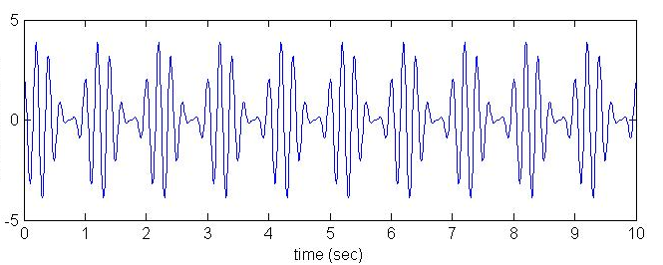
Why learn about signals & systems?
What are the applications of signals & systems?
What information does the signal convey? How do we break it down into its components? How do we know how to reconstruct it?
What happens when the signal goes thru a system?

Slide 11
Applications of Signals & Systems
Communications
Signal Processing
Modelling and Control
Communications
Transmissions of signals over a channel
Requires modulation & demodulation
Analyze spectrum & determine energy/power
Amplification to boost power levels
Filtering to remove noise

Slide 12
Example of an Amplitude Modulation Communications Systems

Slide 13
Signal Processing
Compression for fast, efficient, reliable transmission & data storage
Applied to audio, image and video data eg JPEG, MPEG
Bio-signal processing eg EEG, ECG, biometrics (face recognition, fingerprinting)
Detect abnormal activity
Identity verification
Filtering and reconstruction
Image processing

Slide 14
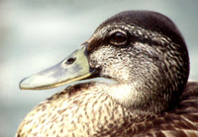


JPEG Example
43K 13K 3.5K
JPEG uses Discrete-Cosine Transform (similar to Fourier Transform)

Slide 15
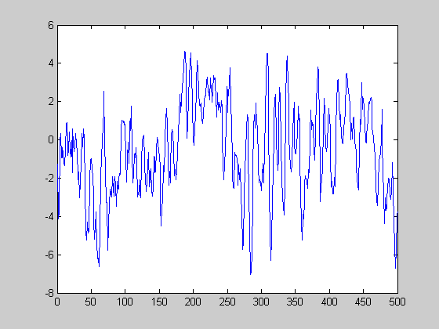
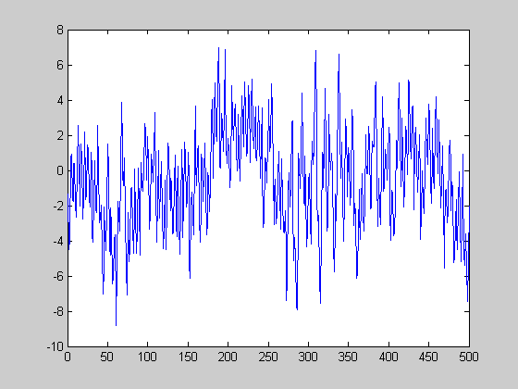
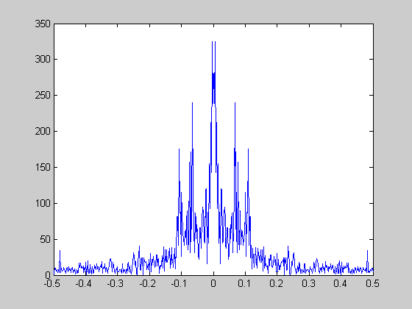
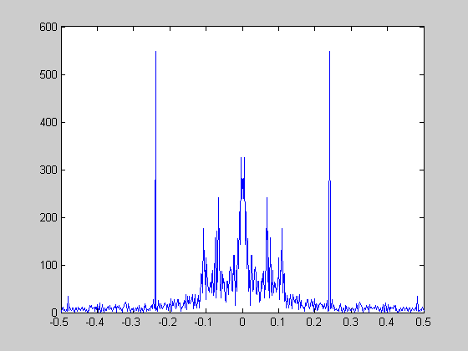
Brain waves are usually contaminated by noise and hard to interpret

Slide 16
Modelling & Control
Modelling in order to predict behaviours, and to simulate behaviours
Control of industrial system eg cruise control in a car, temperature control in a reactor, flight control & navigation, etc
reference / desired speed
+
e
V_{in}
amplifier
motor
-
comparison
sensor
Closed loop control system

